Slide 1
Introduction to NoSQL

Slide 2
Introduction to NoSQL
In the past couple of years, web application development has usually required the usage of relational databases to store persistent data.
Most developers are already pretty comfortable with using one of the many SQL solutions.
So, the approach of storing a normalized data model using a mature relational database became the standard.
Object-relational mappers (ORM) started to crop up, giving developers proper solutions to marshal their data from the different parts of their application.

Slide 3
Introduction to NoSQL (continued)
But as the Web grew larger, more scaling problems were presented to a larger base of developers.
To solve this problem, the community created a variety of key-value storage solutions that were designed for better availability, simple querying, and horizontal scaling.
This new kind of data store became more and more robust, offering many of the features of the relational databases.
During this evolution, different storage design patterns emerged, including key-value storage, column storage, object storage, and the most popular one, document storage.

Slide 4
Introduction to NoSQL (continued)
In a common relational database, your data is stored in different tables, often connected using a primary-to-foreign key relation.
Your program will later reconstruct the model using various SQL statements to arrange the data in some kind of hierarchical object representation.
Document-oriented databases handle data differently.
Instead of using tables, they store hierarchical documents in standard formats, such as JSON and XML.

Slide 5
Introduction to NoSQL (continued)
To understand this better, let's have a look at an example of a typical blog post.
To construct this blog post model using a SQL solution, you'll probably have to use at least two tables.
The first one would contain post information while the second would contain post comments.
A sample table structure can be seen in the following diagram:

Slide 6
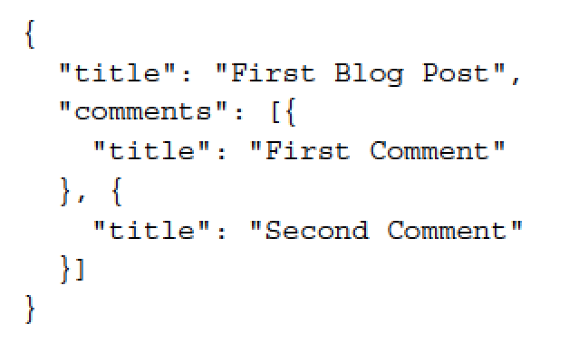
Introduction to NoSQL (continued)
In your application, you'll use an object-relational mapping library or direct SQL statements to select the blog post record and the post comments records to create your blog post object.
However, in a document-based database, the blog post will be stored completely as a single document that can later be queried.
For instance, in a database that stores documents in a JSON format, your blog post document would probably look like the following code snippet:

Slide 7
Introduction to NoSQL (continued)
This demonstrates the main difference between document-based databases and relational databases.
So, while working with relational databases, your data is stored in different tables, with your application assembling objects using table records.
Storing your data as holistic documents will allow faster read operations since your application won't have to rebuild the objects with every read.
Furthermore, document-oriented databases have other advantages.

Slide 8
Introduction to NoSQL (continued)
While developing your application, you often encounter another problem: model changes.
Let's assume you want to add a new property to each blog post.
So, you go ahead and change your posts table and then go to your application data layer and add that property to your blog post object.
As your application already contains several blog posts, all existing blog post objects will have to change as well, which means that you'll have to cover your code with extra validation procedures.

Slide 9
Introduction to NoSQL (continued)
However, document-based databases are often schema-less, which means you can store different objects in a single collection of objects without changing anything in your database.
Although this may sound like asking for trouble to some experienced developers, the freedom of schema-less storage has several advantages.
Using schema-less storage will allow you to define different properties for different objects in the same collection, while still enabling you to query this collection using properties common to all documents.
This means your application, and not the database, will be in charge of enforcing the data structure, which can help you speed up your development process.

Slide 10
Introduction to NoSQL (continued)
While there are many NoSQL solutions that solve various development issues, usually around caching and scale, document-oriented databases are rapidly becoming the leaders of the movement.
The document-oriented database's ease of use, along with its standalone persistent storage offering, even threatens to replace the traditional SQL solutions in some use cases.
And although there are a few document-oriented databases, none are as popular as MongoDB.

